Slide 1


2021
Graduation Ceremony
of the
La Loma Baptist
College and Institute
Pastor Gilbert Toquero, President

Slide 2
Greetings to all of you for this special
2021
Graduation Ceremony
Pastor Toquero has asked me to take part in this wonderful event. It is my honor and privilege to do so.
Thank you, President Toquero.
Please permit me to take you back to the beginning of LBI in 1982, just two years after the La Loma Baptist Church was started.

Slide 3
Here is a picture on the first night of classes.

Slide 4
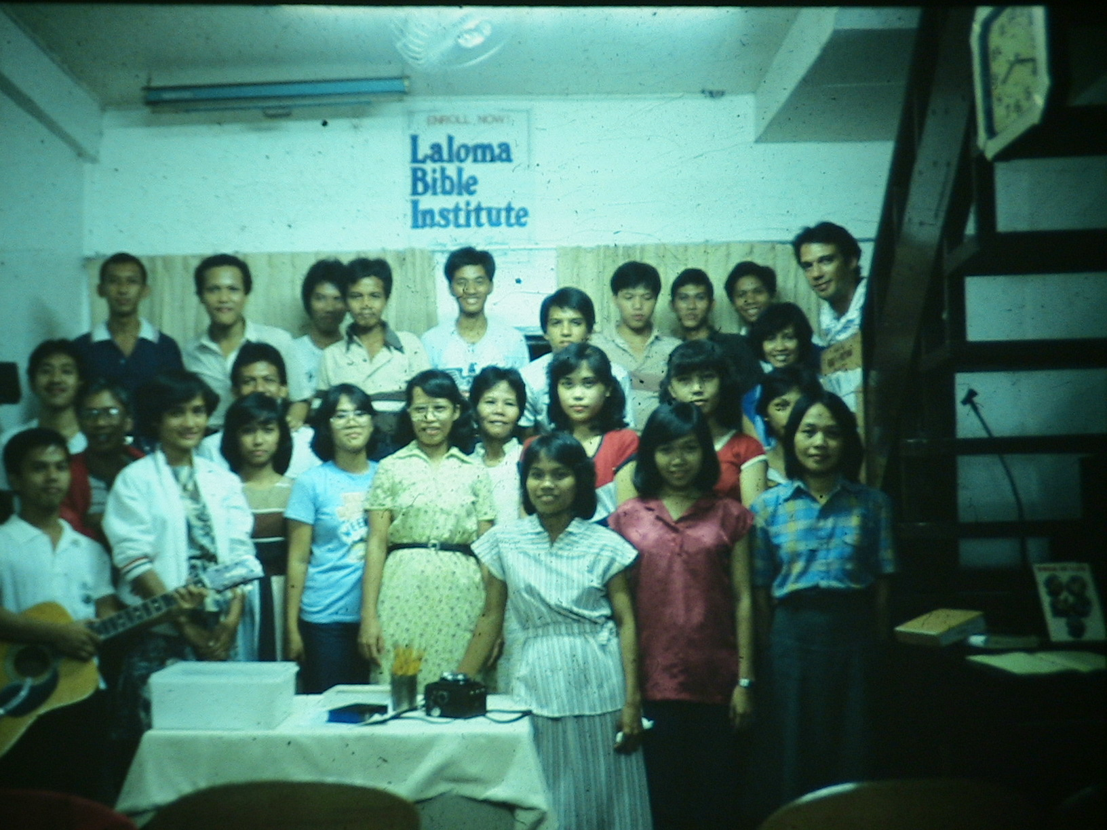

Slide 5
Here is a picture of one of our Graduations on Isarog Street.

Slide 6
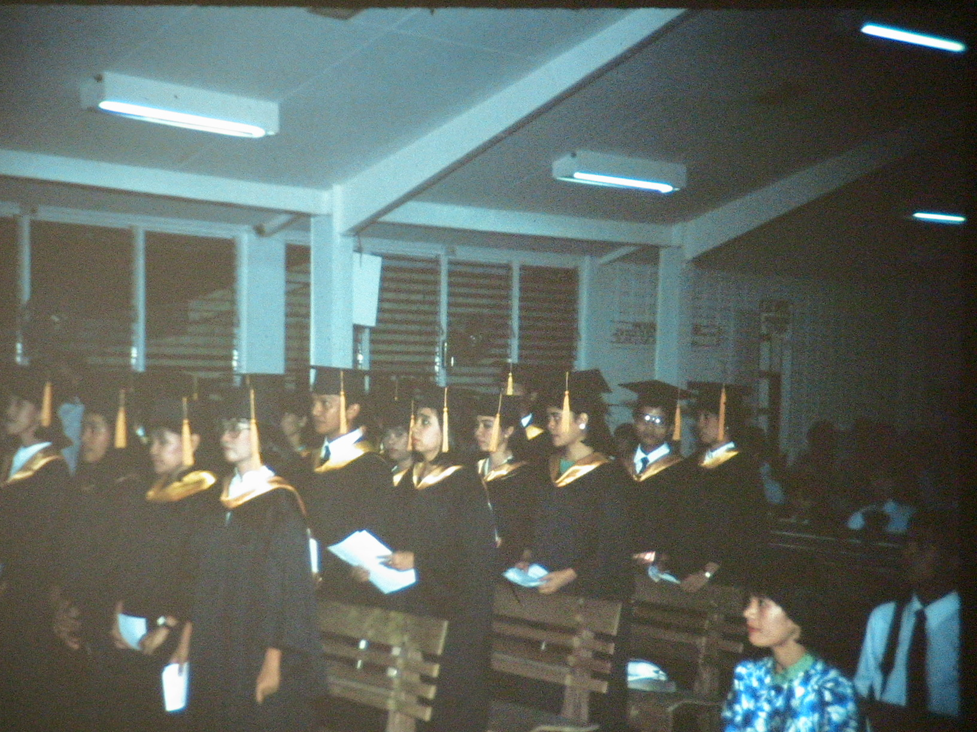

Slide 7
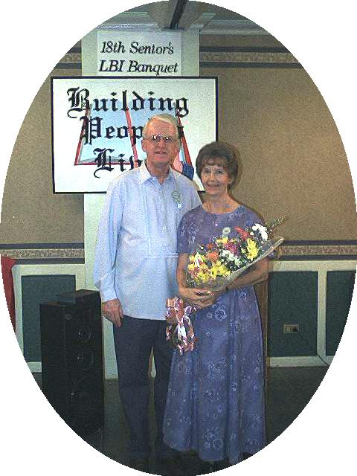

Slide 8
There are many other pictures and videos on the www.bama4u.org/misc website for you to enjoy.
God has truly blessed our Bible Institute ministries there at LBC and around the world.

Slide 9
We give God all the honor, praise and glory for what He has done through the ministry of the La Loma Bible Institute.
2 Tim. 2:1-3 “Thou therefore, my son, be strong in the grace that is in Christ Jesus.
And the things that thou hast heard of me among many witnesses, the same commit thou to faithful men, who shall be able to teach others also.
Thou therefore endure hardness, as a good soldier of Jesus Christ.”

Slide 10
WOULD YOU PLEASE PRAY WITH ME.

Slide 11
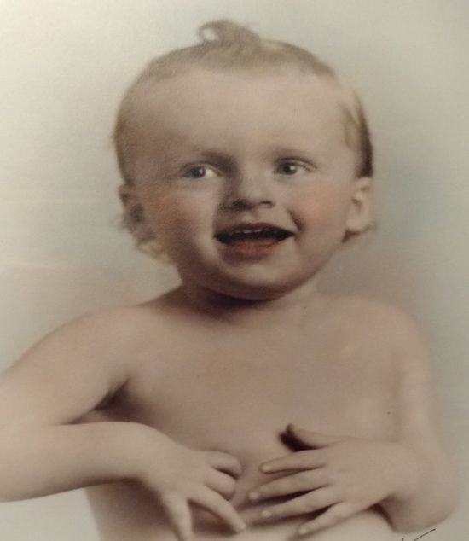
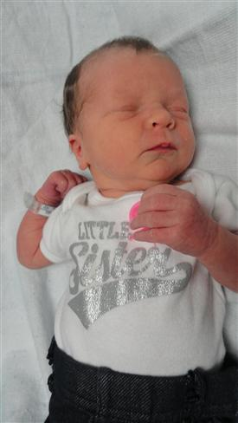
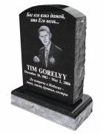
THE BIG DASH
You were Born.
You & I will Die.
This is a fact: 10 out of 10 people will die.
Expiration
Date is
unknown.
Mel, 1 year old
MEL BROWN
The dash represents your life.
How long will that dash be?
WHAT ARE YOU GOING TO PUT INTO YOUR DASH?

Slide 12
What is in your DASH today?
So, what are you planning to do
with the rest of your life?
THE DASH?
YOUR PAST?
YOUR PRESENT? WHAT IS GOING ON RIGHT NOW?
WHAT ABOUT YOUR FUTURE?

Slide 13
DO YOU HAVE SOME GOALS?
LET’S TALK ABOUT YOUR FUTURE
DO YOU
HAVE
A PLAN?
DO YOU HAVE SOME STANDARDS TO LIVE BY?
DO YOU HAVE SOME GUIDE- LINES TO FOLLOW?
Courting?
Occupation?
Relationship with God?
Money?
Winning the lost to Christ?
HAVE YOU SET
ANY BOUNDRIES?

Slide 14
I WANT TO GIVE YOU SIX PEOPLE
WHO SAID “NO”
THESE ARE PEOPLE WHO HAD SOME GODLY BIBLE STANDARDS, AND LIMITS IN THEIR BEHAVOR. THEY SAID “NO” TO SIN AND SAVED THEIR TESTIMONY.

Slide 15
I. DANIEL - was a man who could say NO to King Nebuchadnezzar
Daniel 1:8 “But Daniel purposed in his heart that he would not defile himself with the portion of the king's meat, nor with the wine which he drank: therefore he requested of the prince of the eunuchs that he would not defile himself.”

Slide 16
1 Cor. 3:16 “Know ye not that ye are the temple of God, and that the Spirit of God dwelleth in you? 17 If any man defile the temple of God, him shall God destroy; for the temple of God is holy, which temple ye are. 19 What? know ye not that your body is the temple of the Holy Ghost which is in you, which ye have of God, and ye are not your own?”

Slide 17
II. SHADRACH, MESHACH, AND ABEDNEGO - said NO
Daniel 3:18 “…we will not serve thy gods…”
Acts 5:29 “We ought to obey God rather than men.”
III. QUEEN VASHTI - said NO to her husband the King.
The King said to her, I want you to display yourself before my friends.
Esther 1:12 “But queen Vashti refused to come at the king‘s commandment…”

Slide 18
IV. JOSEPH - said NO
to Potiphar’s wife
Genesis 39:7-12 “And it came to pass after these things, that his master's wife cast her eyes upon Joseph; and she said, Lie with me. 8 But he refused…and said, how then can I do this great wickedness, and sin against God?... and he left his garment in her hand, and fled, and got him out.”
YOU NEED TO SAY NO
TO SIN.

Slide 19
The DASH
in your future should be filled with “NO’S to SIN.”
Say NO NO NO NO NO to SIN
1 Timothy 3:15 “But if I tarry long, that thou mayest know how thou oughtest to behave.…”
Psa. 101:2 “I will behave myself wisely in a perfect way… I will walk within my house with a perfect heart.”

Slide 20
LET ME GIVE YOU
8 BIBLE RULES or GUIDE LINES TO LIVE BY.
God’s people have always asked me, “Is it right or is it wrong to do this or that?”
The Bible is our guide Book.
God has given it to us to follow.
Let us see what God says about it.

Slide 21
IS THIS “THING” RIGHT OR WRONG?
Is “IT” (this thing) clearly forbidden in the Bible?
Psa. 119:105 “Thy word is a lamp unto my feet, and a light unto my path.”
Examples: idols (126 times), working on Sunday, the Lord’s day, giving, drinking wine, homosexuality, abortion-murdering the unborn, etc., etc.

Slide 22
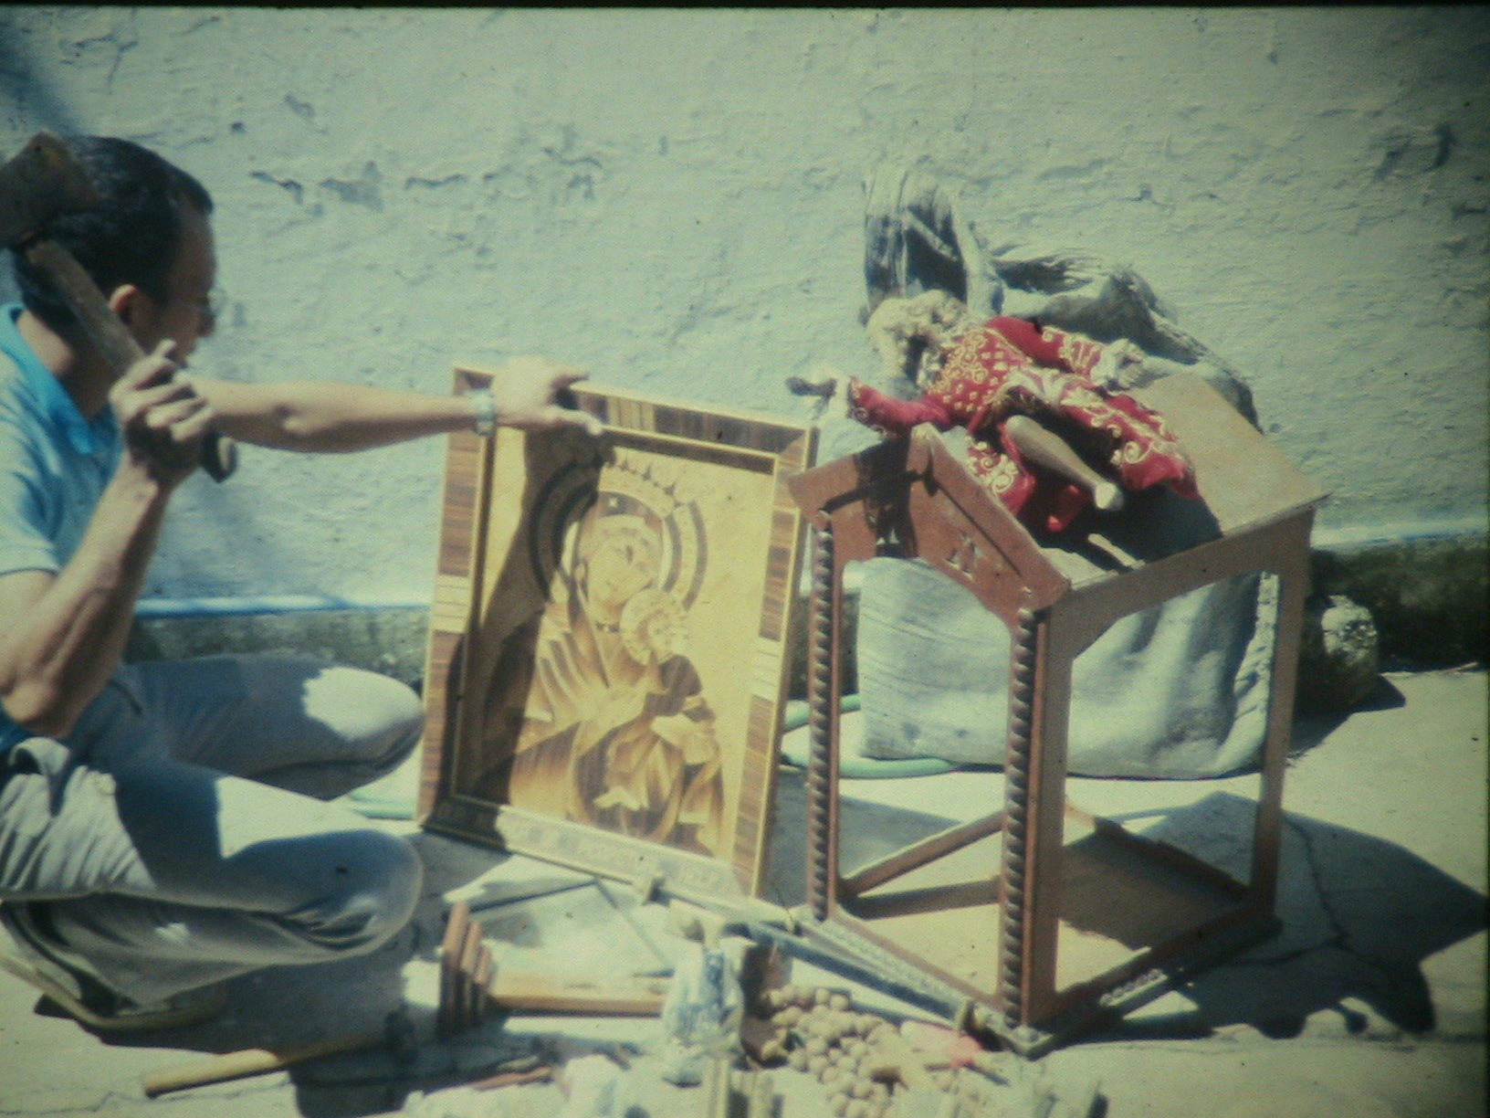

Slide 23
IS THIS “THING” RIGHT OR WRONG?
2. Would “IT”
trouble my conscience?
Act 24:16 “And herein do I exercise myself, to have always a conscience void of offence toward God, and toward men.”
Examples: idols, working on Sunday, the Lord’s day, giving, drinking wine, homosexuality, abortion-murdering the unborn, etc., etc.

Slide 24
IS THIS “THING” RIGHT OR WRONG?
Examples: idols, working on Sunday, the Lord’s day, giving, drinking wine, homosexuality, abortion-murdering the unborn, etc., etc.
3. Will “IT” cause another Christian to stumble or lose fellowship with God?
1 Cor. 8:7-13

Slide 25
IS THIS “THING” RIGHT OR WRONG?
Examples: idols, working on Sunday, the Lord’s day, giving, drinking wine, homosexuality, abortion-murdering the unborn, etc., etc.
4. Will “IT” glorify God?
Will it encourage others?
1 Cor. 10:31 “Whether therefore ye eat, or drink, or whatsoever ye do, do all to the glory of God.”

Slide 26
5. Can I do “IT” in the name of Christ and thank God for it?
Col. 3:17-21 “And whatsoever ye do in word or deed, do all in the name of the Lord Jesus, giving thanks to God and the Father by him. 18 Wives, submit yourselves unto your own husbands, as it is fit in the Lord.
19 Husbands, love your wives, and be not bitter against them. 20 Children, obey your parents in all things: for this is well pleasing unto the Lord. 21 Fathers, provoke not your children to anger, lest they be discouraged.”

Slide 27
6. Will “IT” hinder
my Spiritual growth?
Examples: idols, working on Sunday, the Lord’s day, giving, drinking wine, homosexuality, abortion-murdering the unborn.
Heb. 12:1 “Wherefore seeing we also are compassed about with so great a cloud of witnesses, let us lay aside every weight, and the sin which doth so easily beset us, and let us run with patience the race that is set before us”

Slide 28
Again, Will “IT” hinder
my Spiritual growth?
Eph. 4:30 “And grieve not the holy Spirit of God, whereby ye are sealed unto the day of redemption.”
1 Thes. 5:19 “Quench not the Spirit.”
Examples: idols, working on Sunday, the Lord’s day, giving, drinking wine, homosexuality, abortion-murdering the unborn.

Slide 29
7. Will “IT” keep someone
from being saved?
1 Cor. 10:32-33 “Give none offence, neither to the Jews, nor to the Gentiles, nor to the church of God: 33 Even as I please all men in all things, not seeking mine own profit, but the profit of many, that they may be saved.”
A bad testimony always hurts.

Slide 30
8. Would I be willing for Jesus to come and find me engaged in the activity? Would Jesus do “IT” ?
God observes all our actions.
Heb. 4:13 “Neither is there any creature that is not manifest in his sight: but all things are naked and opened unto the eyes of him with whom we have to do.”

Slide 31
Again, Would I be willing for Jesus to come and find me engaged in the activity? Would Jesus do “IT” ?
“The eyes of the LORD are in every place, beholding the evil and the good.“ Prov. 15:3
Examples: idols, working on Sunday, the Lord’s day, giving, drinking wine, homosexuality, abortion-murdering the unborn.

Slide 32
Ask yourself –
What Would Jesus Do?
WWJD
Someone has said: “We should not ask “Is it wrong?” but “Is it best?”
WWJD?

Slide 33
THE BIG DASH
LIFE IS FULL OF CHOICES!
YOU ARE FREE TO MAKE YOUR OWN CHOICES
AS YOU PLEASE.
HOWEVER, YOU CANNOT CHOOSE THE CONSAQUENCES OF YOUR CHOICES-ACTIONS.

Slide 34
“TRUST AND OBEY
FOR THERE IS NO OTHER WAY,
THEN TO BE HAPPY IN JESUS, IS TO TRUST AND OBEY.”
Deut. 11:26-28 “Behold, I set before you this day a blessing and a curse. A blessing, if ye obey the commandments of the LORD your God, which I command you this day: And a curse, if ye will not obey the commandments of the LORD your God, but turn aside out of the way...”

Slide 35
PLEASE PRAY WITH ME.

