Slide 2
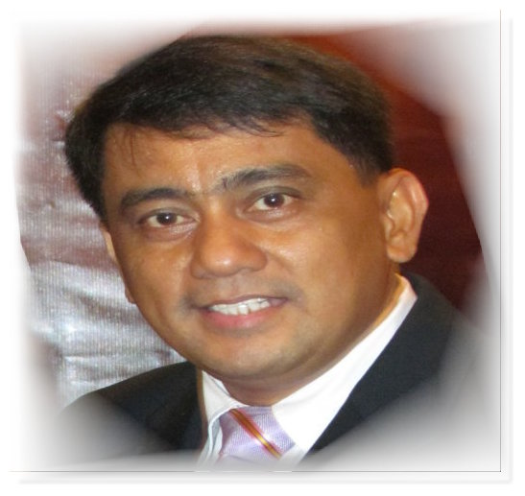

HOME WITH THE LORD JESUS..HEALED

Slide 3
The Apostle Paul wrote in 2 Tim. 4:6-8 “For I am now ready to be offered, and the time of my departure is at hand. I have fought a good fight, I have finished my course, I have kept the faith:
Henceforth there is laid up for me a crown of righteousness, which the Lord, the righteous judge, shall give me at that day: and not to me only, but unto all them also that love his appearing.”
Pastor Toquero continued to witness to others about Jesus even while deathly sick until his last breath. “He fought a good fight, He finished his course, He kept the faith.”

Slide 4
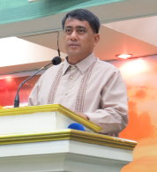
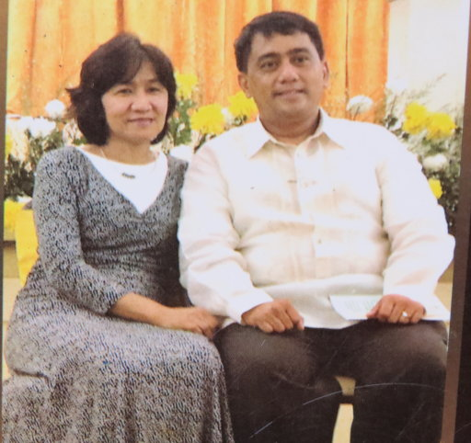
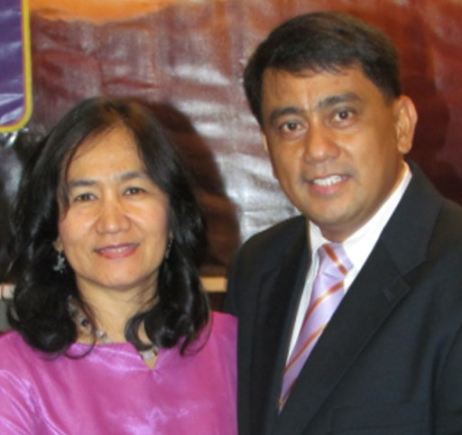
PASTOR GILBERT TOQUERO
IS IN HEAVEN TODAY.
God has blessed my wife Carol (in Heaven) and me for many years with the dear friendship of Pastor & Mrs. Toquero.
What a blessed treasure they have been, working side by side together in the service for our Lord.
All of us will miss Pastor Toquero until we see him in Glory one day.
Truly, a faithful
servant of God.

Slide 5
I was asked to participate in this special victory service and I consider it to be an honor to do so.
I give my loving condolences
to the Toquero family,
the LBC church family, and friends.
I wish I could be there in person to give you my love and this message. I love and miss you dear people more than you will ever know.

Slide 6
My message today will be somewhat bitter sweet. However, it is the message God has laid upon my heart.
The topic of this message is:
DEATH, WHAT COMES NEXT?
Many books have been written about this subject, many testimonies have been spoken and many people “say” they have died and came back to life again. They might be interesting but….

Slide 7
BUT, there is only one BOOK, the BIBLE, that can give us the correct answer about “What comes next after death?”
The BIBLE, is GOD’S holy, inspired, infallible WORD OF GOD.
Every WORD is “God Breathed” and true and we need to be very careful not to disbelieve it, but trust what He tells us is absolutely true. By faith, we do this. God said it, I believe it!

Slide 8
2 Tim. 3:16 says, “All scripture is given by inspiration of God, and is profitable for doctrine, for reproof, for correction, for instruction in righteousness.”
“for doctrine” That is what is right.
“for reproof” That is what is wrong.
“for correction” That is how to get right.
“for instruction in righteousness”
That is how to stay right.
Please permit me to answer
“WHAT IS NEXT AFTER DEATH?”

Slide 9
THERE ARE THREE QUESTIONS
THAT JOB ASKED
THAT WERE ANSWERED BY JESUS
Job asks three important questions about man (you and me). They are so important they need the right answers.
I am so thankful that Jesus answered them and we can know they have been answered correctly.

Slide 10
Job’s first question in the Book of Job in the Old Testament is:
Job 14:10. “But man dieth, and wasteth away: yea, man giveth up the ghost, and where is he?”
“MAN DIETH .... AND WHERE IS HE?"
This is a known fact: Death is certain for everybody. Every one of us will die.
Hebrews 9:27 “…it is appointed unto men once to die, but after this the judgment.”
WHAT IS NEXT AFTER DEATH?
WHAT COMES NEXT?
The words “and he died” are seen 22 times in the Bible. Found 10 times in Genesis chapter 5 alone.

Slide 11
“MAN DIETH .... AND WHERE IS HE?"
Jesus answers this question with the description of two real men who died.
Luke 16:19-31 “There was a certain rich man, which was clothed in purple and fine linen, and fared sumptuously every day:
And there was a certain beggar named Lazarus, which was laid at his gate, full of sores, And desiring to be fed with the crumbs which fell from the rich man's table: moreover the dogs came and licked his sores…

Slide 12
Verse 22 “And it came to pass, that the beggar died, and was carried by the angels into Abraham's bosom: the rich man also died, and was buried.”
These two men had an opportunity to get prepared for eternity while they were alive.
The beggar heard the Gospel and believed what the Bible says about salvation.
The rich man ignored and disbelieved the Gospel of Christ. He did not make any preparations. He may have said, “One day before I die I will get right with God” but he waited too long.

Slide 13
“MAN DIETH .... AND WHERE IS HE?”
Jesus definitely states ten things about the unsaved dead, which was the rich man.
“the rich man also died, and was buried
and in hell…”
1. They are in hell - vs. 23.
“And in hell” Hell is a real place.
2. They can see - vs. 23.
“he lift up his eyes and seeth Abraham afar
off, and Lazarus in his bosom.”
3. They are in torment - vs. 24.
“And he cried and said, Father Abraham, have mercy on me, and send Lazarus, that he may dip the tip of his finger in water, and cool my tongue; for I am tormented in this flame.”

Slide 14
“MAN DIETH .... AND WHERE IS HE?”
4. They can speak - vs. 24.
“And he cried and said” He could talk.
5. They want mercy - vs. 24.
“he cried and said have mercy on me”
Mercy means to hold back from me what I deserve.
6. They want water - vs. 24.
“send Lazarus that he may dip the tip of his
finger in water, and cool my tongue”
7. They are tormented in flames - vs. 24.
“I am tormented in this flame.”

Slide 15
“MAN DIETH .... AND WHERE IS HE?"
8. They can remember - vs. 25.
“But Abraham said, Son, remember…”
9. They can’t have anyone come to them - vs. 26. Abraham said “And beside all this, between us and you there is a great gulf fixed: so that they which would pass from hence (us) to you cannot; neither can they (those who are with you) pass to us, that would come from thence”
In other words: “And besides this, there is a deep ditch between us, and no one from either side can cross over.”
10. Worst of all they can’t get out - vs. 26.
“neither can they pass to us, that would come from thence” There is no hope.

Slide 16
Dear Friend, what you have just heard is a true story from Jesus Christ the only Savior.
“MAN DIETH .... AND WHERE IS HE?”
II. “IF A MAN DIE SHALL HE LIVE AGAIN?”
JESUS DEFINITELY STATES FIVE THINGS ABOUT THE PERSON WHO DIES SAVED.
They are carried by the angels to the place of the righteous - vs. 22.
He “was carried by the angels into Abraham's bosom”
2. They are comforted - vs. 25.
“…now he, Lazarus, is comforted”

Slide 17
3. They are where Jesus is –
Jesus said in John 14:3 “And if I go and prepare a place for you, I will come again, and receive you unto myself; that where I am, there ye may be also.”
4. They are in the presence of the Lord -
II Corinthians 5:8 “We are confident, I say, and willing rather to be absent from the body, and to be present with the Lord.”
“MAN DIETH .... AND WHERE IS HE"?
Eternal Heaven for the prepared person. ☺
Eternal Hell for the unprepared person. ☹

Slide 18
III. “HOW CAN A MAN
BE JUSTIFIED WITH GOD?” Job 25:4
Justified – means, to be made righteous.
Jesus said that man could only be JUST, righteous, by receiving Jesus as our personal savior.
PAUL TEACHES US
THAT WE ARE JUSTIFIED
Savior.
1. By grace = unmerited favor - Romans 3:24 “Being justified freely by His grace through the redemption that is in Christ Jesus.”
2. By blood - Romans 5:9. “Much more than being now justified by His blood, we shall be saved from wrath through Him.”

Slide 19
III. “HOW CAN A MAN
BE JUSTIFIED WITH GOD?” Job 25:4
John 5:24 “Verily, verily, I say unto you, He that heareth my word, and believeth on him (God) that sent me, hath everlasting life, and shall not come into condemnation; but is passed from death unto life (eternal life).”
John 6:47 “Verily, verily, I say unto you, He that believeth on me hath everlasting life.”
Eph. 2:8-9 “For by grace are ye saved through faith; and that not of yourselves: it is the gift of God: Not of works, lest any man should boast.”

Slide 20
THERE ARE THREE QUESTIONS THAT JOB ASKED THAT WERE ANSWERED BY JESUS
“MAN DIETH .... AND WHERE IS HE?”
II. “IF (or when) A MAN DIE
SHALL HE LIVE AGAIN?” Job 14:14.
YES!
III. “HOW CAN A MAN
BE JUSTIFIED WITH GOD?” Job 25:4
Eph. 2:8-9 “For by grace are ye saved through faith; and that not of yourselves: it is the gift of God: Not of works, lest any man should boast.”

Slide 21
“MAN DIETH .... AND WHERE IS HE?”
1John 5:11-13 “And this is the record, that God hath given to us eternal life, and this life is in his Son. He that hath the Son hath life; and he that hath not the Son of God hath not life.”
What kind of life?
Eternal separation from God. ☹
If you have the Son,
Jesus, you have eternal life.

Slide 22
“MAN DIETH .... AND WHERE IS HE?”
If a person dies prepared, they go to HEAVEN.
If a person dies unprepared without Jesus Christ, that person will miss heaven and spend eternity in hell. ☹ That is what God says.
Life is short, eternity is forever.
Each person has a choice while they are alive to either: 1. accept Jesus Christ as their personal Savior or 2. reject God’s free gift of eternal salvation.
THE MOST IMPORTANT THING YOU CAN DO IN LIFE IS TO GET PREPARED TO DIE!

Slide 23
Are you 100% sure of going to Heaven when you die? If not, pray this prayer
Dear Lord Jesus, I know that I am a sinner.
Go ahead and say it if you mean it.
I believe that you are the Son of God.
I believe that you died on the cross for me, was buried and rose again the third day.
I ask you, by faith, to come into my heart and life right now and save me from all my sins and give me eternal life. Thank you Lord Jesus for coming in as you promised.
I pray this prayer in Jesus Name. Amen

Slide 24
If you prayed that prayer and meant it with all your heart then you can claim this promise:
1John 5:11-13 “And this is the record, that God hath given to us (you) eternal life, and this life is in his Son. He that hath the Son hath life (eternal life); and he that hath not the Son of God hath not life. These things have I written unto you that believe on the name of the Son of God; that ye may know that ye have eternal life, and that ye may believe on the name of the Son of God.”

Slide 25
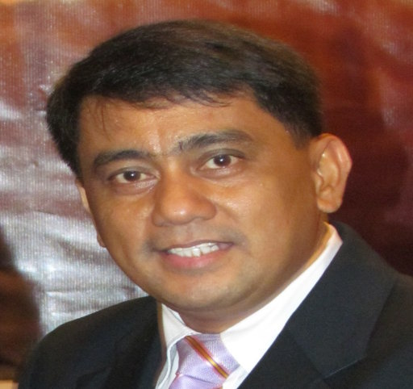
This is their testimony
PASTOR AND MRS. TOQUERO ACCEPTED JESUS CHRIST AS THEIR LORD AND SAVIOR IN THE 1980s.
SINCE THAT TIME
THEY HAVE BEEN LEADING PEOPLE
TO CHRIST. TRAINING
MEN AND WOMEN
FOR THE MINISTRY.
PLANTING CHURCHES AND BIBLE INSTITUTES.
PASTOR TOQUERO,
WE WILL MISS YOU. WE WILL CONTINUE ON WITH GOD’S WORK AS YOU FAITHFULLY DID.
HE WAS A GODLY PASTOR AND LEADER.

Slide 26
HOME WITH THE LORD JESUS FOREVER
Date of Birth:
December 26, 1965
Date of Home Going:
September 3, 2021
Age at Home Going:
55 yrs and 8 mo.
Date of Salvation:
May 16, 1986 (20 yrs old)

Slide 27
PASTOR, WOULD YOU
PLEASE COME AND GIVE
THE INVITATION.

