Slide 2
Pastor Ramil asked me to speak today for our
41^{st.} CHURCH ANNIVERSARY
Please, pray with me.

Slide 3
Quickly, let me give you a short history since 1980
Let us see a little of what God has accomplished since 1980.

Slide 4
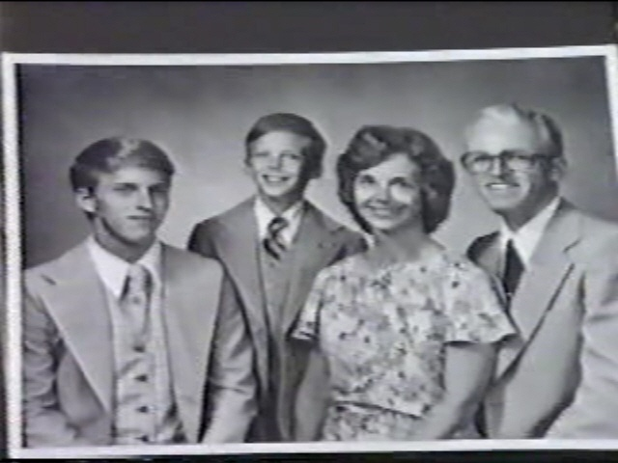
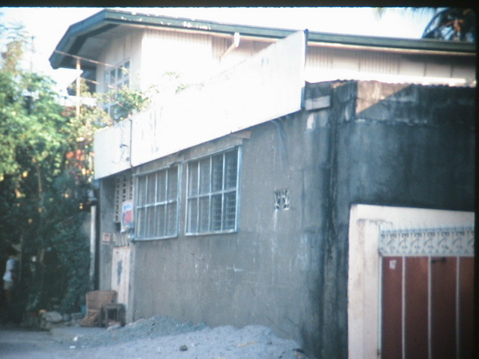
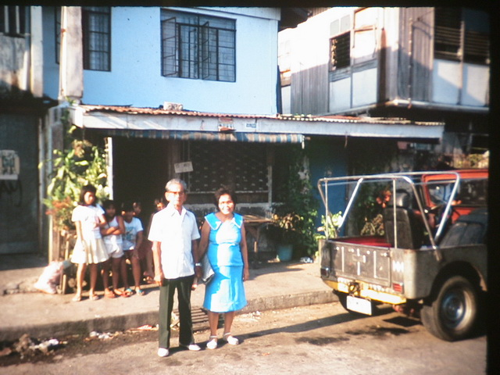
FROM A HUMBLE BEGINNING
WITH ONLY A VISION OF
PLANTING ONE CHURCH.
OUR FAITH WAS VERY SMALL
BUT LOOK WHAT OUR GOD
HATH DONE!
The Brown family arrived in
the Philippines on July 1, 1980
We organized LBC in this place
on Sept. 27, 1980
First location – 1980 In a house, up stairs.
Our 2^{nd.} location – 1980 In a carport.

Slide 5
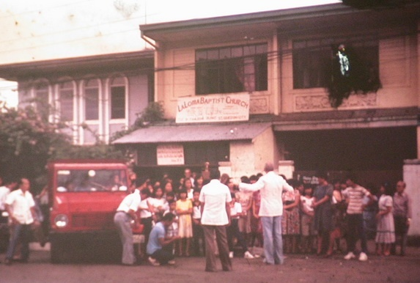
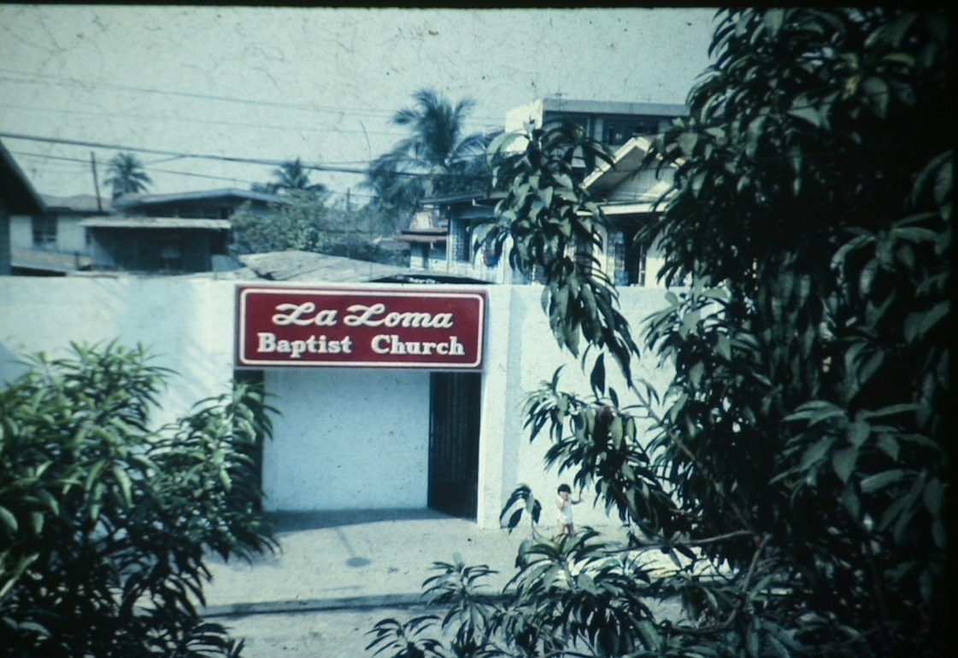
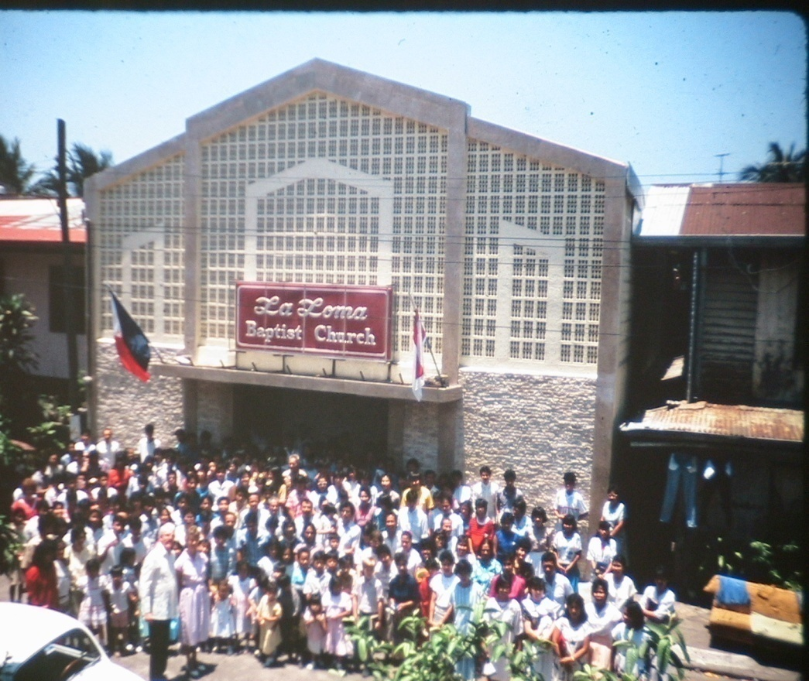
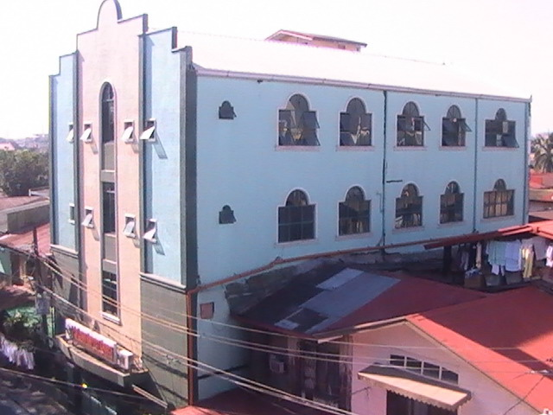
4^{th.} Location
133 Isarog St., LaLoma, Q.C.
1945 U.S. Army Quonset hut.
3^{rd.} location – 1980
In this apartment.
Same location.
Built over the
building on left.
We built this building
over the Quonset hut.

Slide 6
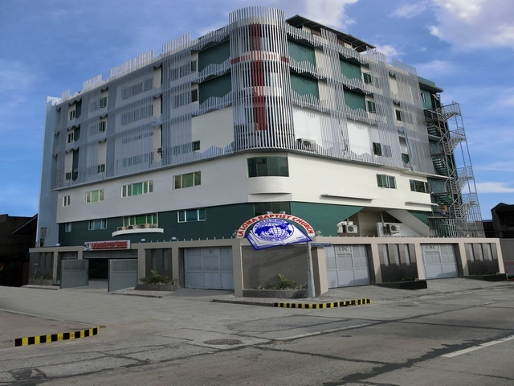
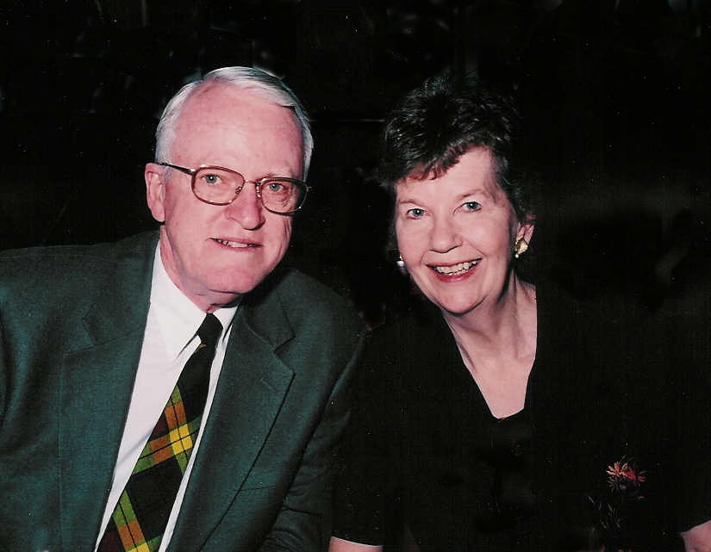
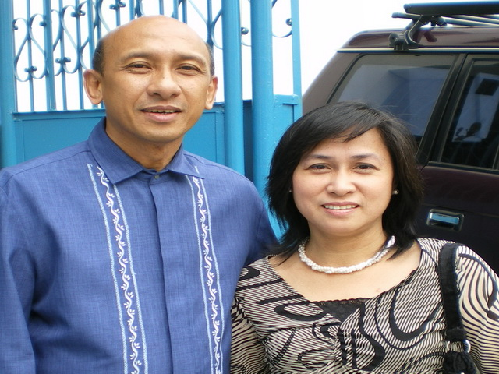
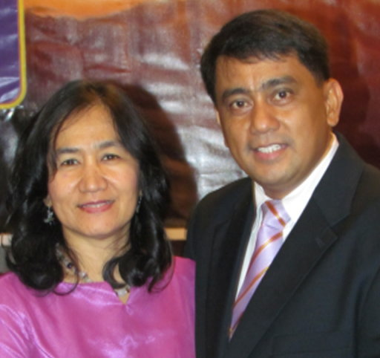
Founder
Pastor & Mrs. Melvyn Brown
1980-1987
Our present location
1^{st.} National Pastor,
Pastor & Mrs. Estipona 1987-1996
Pastor & Mrs. Toquero
1996 – 2021

Slide 7
TO GOD BE
ALL THE GLORY
FOR WHAT HE HAS DONE!
WITHOUT GOD,
THIS 41 YEAR HISTORY LESSON
WOULD HAVE NEVER HAPPENED.
WITHOUT GOD,
NONE OF US WOULD BE SETTING
HERE ALIVE, BREATHING, SEEING,
HEARING, AND ENJOYING THIS
WONDERFUL SERVICE!

Slide 8
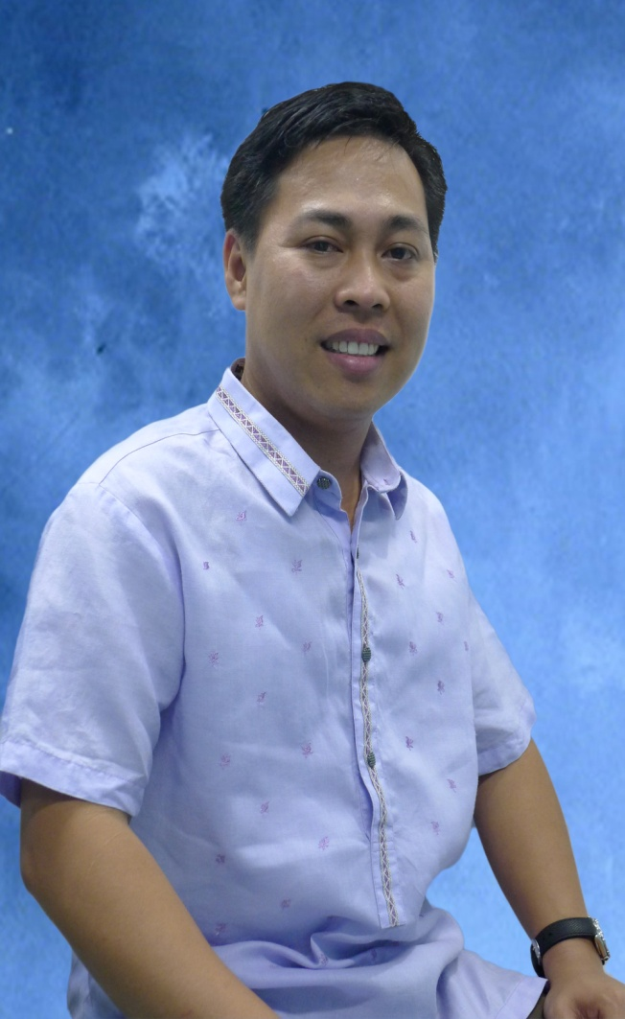
And now,
we have a new Pastor.
Pastor Ramil L. Olalia is not a stranger to any of us because he has been Pastor Toquero’s most faithful, loyal and trusted assistant for the last 11 years.
Pastor Ramil has had responsibilities in every aspect of the LaLoma Baptist Church and all its ministries.

Slide 9
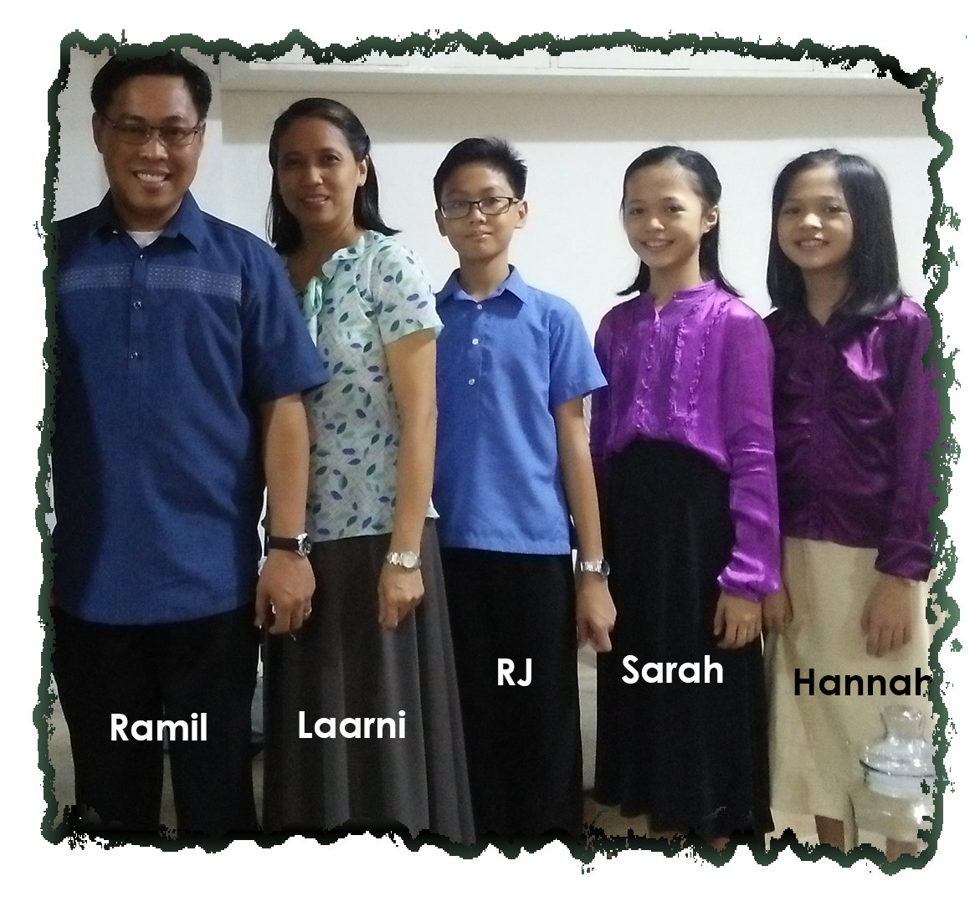
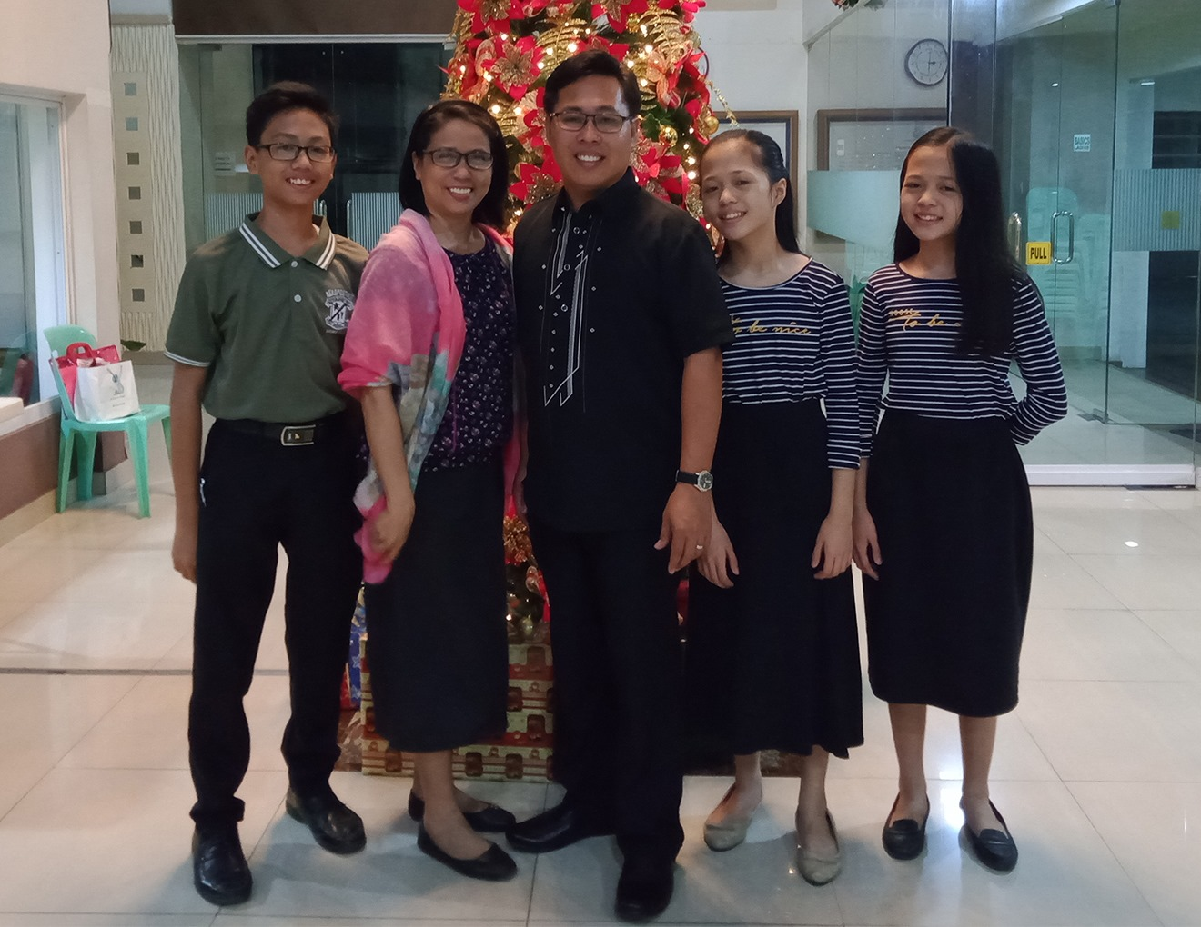
We have a new Family.
WOULD YOU PRAY DAILY FOR THEM?

Slide 10
TODAY IS OUR 41^{ST.} CHURCH ANNIVERSARY!
CHURCH? WHAT IS IT?
WHAT DOES THE WORD CHURCH MEAN?
Although "church" has come to mean a building or organization, the Greek word, for church is ekklesia which means “called out ones.” It is a gathering, an assembly and is the basis for our word congregation.

Slide 11
The Greek word ekklesia means “called out ones”
Buildings are not “the church”.
Every saved, born again, baptized believer is the church,
the body of Christ.
We, the saved ones, who have put our faith and trust in the finished work of the Lord Jesus Christ,
we are the church.
This building is only the place where the saved ones, “the called out ones” the church, meet.

Slide 12
The Greek word for church is ekklesia, which means “called out ones”
When a person turns from their sin, repents, and they put their faith in Jesus Christ, they are “called out” of this world system into the family of God, the church.
The ekklesia of the New Testament refers only to those baptized believers who regularly assemble together, led by the pastors and deacons, for the purpose of worship, instruction, fellowship, and evangelism.
OUR CHURCH IS NOT A SHOWCASE, BUT IS LIKE A HOSPITAL, REACHING LOST PEOPLE WITH THE GOSPEL OF JESUS CHRIST. BAPTIZING THEM, AND TEACHING THEM TO GROW IN GRACE AND REACHING OTHERS WITH THE GOSPEL.

Slide 13
THE BIBLE, IS OUR ONLY SOURCE FOR FAITH AND PRACTICE.
We believe the Bible is the inspired and preserved Word of GOD.
2. We only use the King James version in our church, Bible Institute, college, grammar and H.S.
2 Tim. 3:16 “All scripture is given by inspiration of God, and is profitable for doctrine, for reproof, for correction, for instruction in righteousness:”
Matthew 24:35 Jesus said: “Heaven and earth shall pass away, but my words shall not pass away.”
3. The KJV is the authorize version. All others are unauthorized.

Slide 14
So, there are three groups of people within the
LaLoma Baptist Church.
The Pastor, he is our shepherd, teacher, etc., etc.
2. The Deacons, they are the servants, to the Pastor & members.
3. All saved, baptized belivers are the members of LBC.
These become members of LBC by baptism or by letter.

Slide 15
Here are the responsibilities of the Pastor and the members.
The Pastor, he is our shepherd, teacher, etc.
The Pastor leads his sheep.
The Pastor feeds his sheep the Word of God, the Bible.
The Pastor loves and cares for his sheep.
The Pastor has to give an account to God for his sheep.

Slide 16
Heb 13:17 “…for they (the Pastor) watch for your souls, as they (the Pastor) that must give account (to God), that they (the Pastor) may do it with joy, and not with grief: for that is unprofitable for you (the members).”

Slide 17
These are the responsibilities
of the members of LBC.
2. The members are to be faithful in their church attendance.
IT TAKES 3 TO THRIVE.
Heb 10:25 “Not forsaking the assembling of ourselves together, as the manner of some is; but exhorting one another: and so much the more, as ye see the day approaching.”
1. Sunday morning – Sunday School.
2. Sunday afternoon service.
3. Wednesday Prayer time and Bible
Study.
If you really love the Lord you will be faithful in the above services.

Slide 18
These are the responsibilities
of the members of LBC.
2. The members are to be faithful in their church attendance.
3. The members are to pray for the Pastor and the services.
4. The members are to listen
carefully to the sermons and obey.
Heb 13:7 “Remember them (Pastor) which have the rule over you, who have spoken unto you the word of God: whose faith follow, considering the end of their conversation.”

Slide 19
Heb 13:17 “Obey them (the Pastor) that have the rule over you, and submit yourselves: for they watch for your souls, as they that must give account, that they may do it with joy, and not with grief: for that is unprofitable for you.”

Slide 20
WE MUST PUT THESE PRIORITIES IN THE ORDER OF THEIR IMPORTANCE.
My personal relationship /
fellowship with God.
Mat 6:33 But seek ye first the kingdom of God, and his righteousness; and all these things shall be added unto you. (Food, water, shelter, clothing)
KEEP FIRST THINGS FIRST!!!
Have a place, a time, alone, cell phone OFF.
Listen to God first. Read your Bible daily –THINK! What is God telling me?
Then let God listen to you. Talk to Him in prayer. Thank Him, Praise Him, then ask Him….

Slide 21
My personal relationship with God.
2. My personal fellowship with my family.
I REALLY NEED GOD here.
1^{st.} Your wife or husband.
Love her as Christ loves the church. Demonstrate it.
Men, Listen to her. Stop what you are doing. Do not answer your cell phone. Look at her. Listen, listen.
Spend time with her.
KEEP YOUR ROMANCE ALIVE.

Slide 22
My personal relationship /
fellowship with God.
2. My personal fellowship with my family.
1 Peter 3:7 “Likewise, ye husbands, dwell with them according to knowledge, giving honour unto the wife, as unto the weaker vessel, and as being heirs together of the grace of life;
that your prayers be not hindered.”
1^{st.} Your wife.
2^{nd.} Your children.

Slide 23
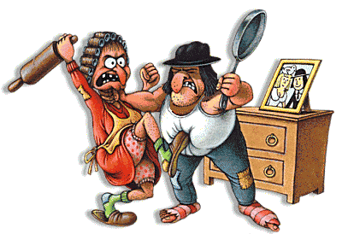
1^{st.} Your wife.
2^{nd.} Your children.
Love them. Love them equally. No partiality.
Encourage them. Compliment them.
Always accept them. Love them always, like God…….
Don’t preach at them.
Control your anger. Anger is a choice.
Give them Bible discipline with love.
Don’t let your pride and your image get in the way.
PUT YOUR FAMILY BEFORE YOUR CHURCH-Your Job.

Slide 24
3^{rd.} Your children.
A word of caution: Be sure you are not too judgmental about other parent’s children.
Mat 10:34-36 Think not that I am come to send peace on earth: I came not to send peace, but a sword. 35 For I am come to set a man at variance against his father, and the daughter against her mother, and the daughter in law against her mother in law. 36 And a man's foes shall be they of his own household.
This could happen when your children are grown and in their 60s. KEEP LOVING THEM LIKE GOD LOVES THEM.

Slide 25
YOU MUST PUT THESE PRIORITIES IN THE ORDER OF THEIR IMPORTANCE.
My personal relationship /
fellowship with God.
2. My personal fellowship with my family.
My wife and children before
3. My Church and My Job.

Slide 26
1. GOD
2. FAMILY
3. CHURCH
FIGHT TO KEEP THESE IN THEIR PROPER ORDER
Be careful who you associate with. Other people may not have the same beliefs and philosophies that you have.
DO NOT REMOVE OR CHANGE THE LANDMARKS OF LBC.
Continue to win souls, disciple them, baptize them and
teach them the Word of God faithfully.

Slide 27
1. GOD
2. FAMILY
3. CHURCH
FIGHT TO KEEP THESE IN THEIR PROPER ORDER
Don’t forget to reproduce yourself.
2 Tim. 2:2-3 “And the things that thou hast heard of me among many witnesses, the same commit thou to faithful men, who shall be able to teach others also.” We are born again to reproduce.
WE DO NOT HAVE MUCH TIME UNTIL WE HEAR THE TRUMPET.
SO, LET JESUS FIND YOU DOING FIRST THINGS FIRST IN THEIR PROPER ORDER OF IMPORTANCE.

Slide 28
TODAY, I HAVE GIVEN YOU SOME OF THE LANDMARKS OF LBC.
THE KJV BIBLE, IS OUR ONLY SOURCE FOR FAITH AND PRACTICE.
The Pastor, he is our shepherd, teacher, etc., etc.
2. The Deacons, they are the servants.
3. Members, all saved, and
baptized and faithful.

Slide 29
LBC - OUR MAIN PURPOSES
THE KJV BIBLE, IS OUR ONLY SOURCE FOR FAITH AND PRACTICE.
My personal relationship /
fellowship with God.
2. My personal fellowship with my family.
3. My Church. I am faithful.

Slide 30
LBC - OUR MAIN PURPOSES
Our goal and desire is to help each member to live a victorious life.
Every service is tailored to help you grow in your spiritual life.
WE ARE HERE TO HELP YOU TO BECOME A GOOD CHRISTIAN, FOR THE GLORY OF GOD.

Slide 31
WE HAVE A MANDATE FROM JESUS
Mat 28:19 “Go ye therefore, and teach all nations, baptizing them in the name of the Father, and of the Son, and of the Holy Ghost:
Verse 20 Teaching them to observe all things whatsoever I have commanded you: and, lo, I am with you alway, even unto the end of the world. Amen.”

Slide 32
WE HAVE A MANDATE FROM JESUS
Act 1:8 “But ye shall receive power, after that the Holy Ghost is come upon you: and ye shall be witnesses unto me both in Jerusalem, and in all Judaea, and in Samaria, and unto the uttermost part of the earth.”
Here, there, next door, across the street, North, South, everywhere.

Slide 33
Act 1:9 “And when he had spoken these things, while they beheld, he was taken up; and a cloud received him out of their sight. And while they looked stedfastly toward heaven as he went up, behold, two men stood by them in white apparel; Which also said,….
Ye men of Galilee, why stand ye gazing up into heaven? this same Jesus, which is taken up from you into heaven, shall so come in like manner as ye have seen him go into heaven.”
JESUS IS COMING SOON!

Slide 34
1 John 3:3 says, “And every man that hath this hope (expectation) in him purifieth himself, even as he is pure.”
JESUS IS COMING SOON!
Are you ready if Jesus were to come today?
Are you ready,
100% ready, if you died today?

Slide 35
JESUS IS COMING SOON!
Pastor Ramil,
Would you please come
and give the invitation?

Slide 36
I welcome your response
The Pastor will send me the attendance there in his church and the decisions that were made, and I will rejoice with him.
If you have been watching by social media, I would be interested in hearing from you if you made a decision in your heart while viewing the message or afterwards.

Slide 37
I welcome your response
Please respond by sending me an e-mail giving me your decision.
My address is bama4u@bellsouth.net
I have a helpful website, www.bama4u.org that you might check out. It will give you a lot of free information and help to assist you in growing in you faith.
Thank you. Mel Brown

