Slide 1
Greetings to all of you.
Pastor Estipona asked me to prepare a
message about “JESUS, THE SON OF GOD.”
Most of my sermons are topical, like: “How to pray”, “How to forgive others” or “How to win souls to Christ”.
“JESUS, THE SON OF GOD” is not like a “How to” message. It is more of a study on the person of who Jesus is.
Please permit me to sing a song before I teach this study of Jesus.

Slide 2
I LOVE THIS SONG
More about Jesus would I know, More of His grace to others show; More of His saving fulness see, More of His love who died for me.
Refrain
More, more about Jesus, More, more about Jesus; More of His saving fulness see, More of His love who died for me.
More about Jesus let me learn, More of His holy will discern; Spirit of God my teacher be, Showing the things of Christ to me

Slide 3
WOULD PLEASE PRAY WITH ME?

Slide 4
WHO IS THIS JESUS?
WHO IS JESUS?

Slide 5
WHO IS THIS JESUS?
Listen to what others have said:
While the Pharisees were gathered together, Jesus asked them,
“What think ye of Christ?
whose son is he?” Matthew 2:42

Slide 6
Matthew 16:13-15
“When Jesus came into the coasts of Caesarea Philippi, he (Jesus) asked his disciples, saying, Whom do men say that I the Son of man am?
And they said, Some say that thou art John the Baptist: some, Elias; and others, Jeremias, or one of the prophets.
He (Jesus) saith unto them,
But whom say ye that I am?”

Slide 7
Matthew 16:16-17
“And Simon Peter answered and said,
Thou art the Christ, the Son of the living God.
And Jesus answered and said unto him, Blessed art thou, Simon Barjona: for flesh and blood hath not revealed it unto thee, but my Father which is in heaven.” Mat. 16:16-17

Slide 8
WHO IS JESUS?
More than 100 billion people (says Goodle) have lived on the earth since God created Adam.
These people have been black, white, red, brown, and yellow. They have spoken many different languages and hundreds of dialects.
They have practiced multitudes of religions.
They are a variety of cultures.

Slide 9
But everyone of these 100 billion in all these varied places and different backgrounds and time periods have one thing in common.
Their eternal destiny and their life style depends upon their relationship to one single person.
That person is JESUS CHRIST.

Slide 10
SOMEONE WROTE:
Someone wrote:
He came from the bosom of the Father to the bosom of a woman.
He put on humanity that we might put on divinity.
He became the Son of Man that we might become the sons of God.
He came from Heaven, where cold winds never blow, frosts never chilled the air; where no one is ever sick; where no one ever dies.
He was born contrary to the laws of nature.
He lived in poverty.

Slide 11
SOMEONE WROTE:
Only once did He cross the boundary of His homeland, and that in His childhood.
He had neither training or education.
He had no wealth or influence.
In infancy He startled a king; in boyhood He puzzled the doctors.
In manhood He ruled the course of nature.
He walked upon the billows and hushed the sea to sleep.

Slide 12
SOMEONE WROTE:
He never wrote a book, yet all the libraries could not hold the books that have been written about Him.
He never wrote a song, yet He has been the theme of more songs than all other subjects combined.
He never founded a college, yet all the schools together cannot match as many students as those who studied His life.
He never practiced medicine, yet He healed more broken bodies than all the doctors that have ever lived.

Slide 13
SOMEONE WROTE:
Great men have come and gone, yet He lives on.
Herod could not kill Him.
Satan could not seduce Him.
Death could not destroy Him.
The grave could not hold Him.
He laid aside His purple robe for a peasant's gown.
He was rich, yet for our sakes He became poor.
How Poor?
Ask Mary. He slept in another man’s manger.

Slide 14
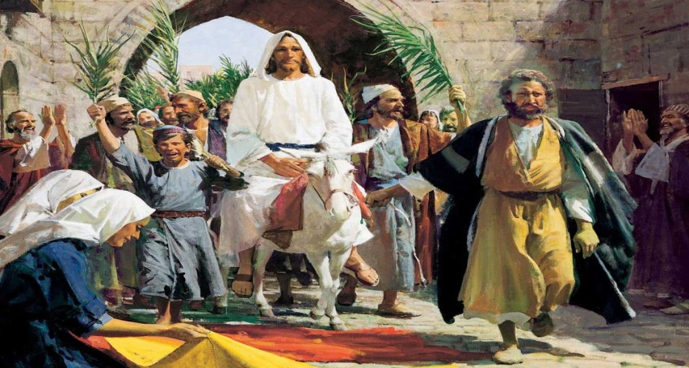
SOMEONE WROTE:
How Poor?
Ask the wise men, who brought Him the gifts.
Ask the disciples. He crossed the lake in another man’s boat.
He rode on another man’s donkey.
He was buried in another man’s tomb.
All others have imperfections, but He none.
He is “the chiefest of ten thousand”
“He is altogether lovely.”
And He is our Saviour, the Lord Jesus Christ.

Slide 15
JESUS
Jesus said that He is the Son of God. Is that really true? What do you think
about His statement? What do
you believe? Is it really true or not?
We need to find out because our destiny depends upon it.
WHO IS THIS JESUS?

Slide 16
HOW ARE WE GOING TO FIND THE ANSWER?
WHERE ARE WE GOING TO FIND THE ANSWER?
THE BIBLE
THERE IS ONLY ONE PLACE
“It is written, Man shall not live by bread alone, but by every word that proceedeth out of the mouth of God.” Matt. 4:4
Rom. 10:17 “So then faith cometh by hearing, and hearing by the word of God.”
READ AND STUDY
YOUR BIBLE
Matthew 22:29 “Jesus said, Ye do err, (do wrong)
not knowing the scriptures, nor the power of God.”

Slide 17
HOW ARE WE GOING TO FIND THE ANSWER?
The BIBLE is the Word of God. God wrote it.
2 Tim. 3:16 says, “All scripture is given by inspiration of God...”
Psalms 45:1 God said “…my tongue is the pen of a ready writer.”
God preserved the Word of God.
Mat. 24:35 “Heaven and earth shall pass away,
but my words shall not pass away.”
Psalms 12:6-7 “The words of the LORD are pure words: as silver tried in a furnace of earth, purified seven times. Thou shalt keep them, O LORD, thou shalt preserve them from this generation for ever.”
.”

Slide 18
NOW, LET US LOOK AT SOME FACTS
I. JESUS WAS PRESENT WITH GOD THE FATHER
AND GOD THE SPIRIT BEFORE CREATION.
The pre-existence of Christ is one of the most fascinating truths of the Bible. John the Baptist was born six month BEFORE Jesus and yet John made this statement , “He that cometh after me was before me.” (John 1:15)
The apostle John wrote, “In the beginning was the Word, and the Word was with God, and the Word was God.” (John 1:1)
A few verses later, he wrote, “And the Word became flesh and dwelt among us and we beheld His glory as of the only begotten of the Father, full of grace and truth.” (John 1:14)

Slide 19
NOW, LET US LOOK AT SOME FACTS
1. Jesus Christ created everything.
Col. 1:14 “In whom (Christ) we have redemption through his (Christ) blood, even the forgiveness of sins:
15 Who (Christ) is the image of the invisible God, the firstborn of every creature:
16 For by him (Christ) were all things created, that are in heaven, and that are in earth, visible and invisible, whether they be thrones, or dominions, or principalities, or powers: all things were created by him (Christ), and for him (Christ):
17 And he (Christ) is before all things, and by him (Christ) all things consist.”

Slide 20
NOW, LET US LOOK AT SOME FACTS
1. Jesus Christ created everything.
2. He controls everything.
We are taught in the Bible that after He created everything He then controlled it and kept it in place.
In Col. 1:17 we read, “And he (Jesus) is before all things, and by him (Jesus) all things consist.” The word consist here means, holds it together.
3. He was in communion with the Father.
Jesus spoke of the love that the Father had for Him before the foundation of the world. (John 17:24) There was perfect harmony and agreement in the Trinity. They said, “Let us make man in our own image.” (Gen. 1:26) And again at the tower of Babel the Trinity spoke saying , “Let us go down and confuse their tongues.” Gen.11:7

Slide 21
LET US LOOK AT SOME FACTS
I. JESUS WAS PRESENT WITH GOD THE FATHER
AND GOD THE SPIRIT BEFORE CREATION.
1. Jesus Christ made everything.
2. He controls everything. He holds everything together.
3. He was in Communion with the Father.
II. JESUS AND HIS INVOLVEMENT IN THE VIRGIN BIRTH.
Isaiah had prophesied (foretold) years before that a virgin would conceive and bring forth a son and His name would be called Immanuel: Isa. 7:14 “Therefore the Lord himself shall give you a sign; Behold, a virgin shall conceive, and bear a son, and shall call his name Immanuel.”
Immanuel means (God With Us)

Slide 22
NOW, LET US LOOK AT SOME FACTS
1 Tim. 3:16 “And without controversy great is the mystery of godliness: God was manifest in the flesh, justified in the Spirit, seen of angels, preached unto the Gentiles, believed on in the world, received up into glory.”
Dr. John Rice wrote, “all Christianity stands or falls with the doctrine of the virgin birth.”
Dr. John Walvoord said , “The incarnation of the Lord Jesus Christ through the Virgin Birth is the central fact of Christianity. Upon it the whole superstructure of Christian theology depends.”

Slide 23
III. JESUS WAS COMPLETELY A HUMAN BEING.
Jesus had human parents. Even though Joseph was not the human father of Jesus he was still His parent.
Luke tell us that Mary physically gave birth to the Son of God.
“And, behold, thou shalt conceive in thy womb, and bring forth a son, and shalt call his name JESUS.” (Luke 1:31)
Jesus had a human body, a soul, and a spirit.
In (Matt 26:12) Jesus said, “For in that she (a woman having an alabaster box) hath poured this ointment on my body, she did it for my burial.”

Slide 24
IV. JESUS WAS COMPLETELY A HUMAN BEING.
In (John 12:27) He said, “Now is my soul troubled; and what shall I say? Father, save me from this hour: but for this cause came I unto this hour.”
Again, the Bible says in (Mark 2:8)
“And immediately when Jesus perceived in his spirit that they so reasoned within themselves, He said unto them, Why reason ye these things in your hearts?”
Jesus looked like a man. Mary mistook Him for the gardener at the tomb. We read that He grew in stature and wisdom. (Luke 2:40) He asked questions of those around Him. (Luke 2:46) He prayed.

Slide 25
JESUS WAS COMPLETELY A HUMAN BEING.
(Luke 11:1) He was tempted. (Matt. 4:1) He learned obedience. (Heb. 5:8) He hungered. (Matt. 4:2) He thirsted. (John 4:7) He was weary. (John 4:6) He slept. (Matt. 8:24) He loved.
(Mark 10:21) He had compassion. (Matt. 9:36) He was angered and grieved. (Mark 3:5) He wept. (John 11:35)
He rejoiced. (Heb. 11:2) He was troubled. (John 11:33)
He sweat. (Luke 22:44) He suffered. (1 Pet. 4:1) He bled. (Matt. 27:50) He was buried.

Slide 26
PLEASE THINK ABOUT THIS
You need to think about what the
Bible is saying to you and believe
it with the faith God is giving you.
“…God was manifest in the flesh…” 1 Tim. 3:16
Who are you going to believe? Some friend, some teacher, some book?
You better put your faith and trust in the Word of God, the Bible. Your destiny depends on it.

Slide 27
MORE BIBLE FACTS
IV. JESUS WAS GOD IN A HUMAN BODY.
1. As seen in the Old Testament.
Isaiah said, “His name shall be called Wonderful, Counselor, Mighty God, Everlasting Father, the Prince of Peace.” (Isa. 9:6)
Daniel said of Him, “Behold one like the Son of Man came with clouds of Heaven.” (Dan. 7:13)

Slide 28
MORE BIBLE FACTS
IV. JESUS WAS GOD IN A HUMAN BODY.
1. As seen in the Old Testament.
2. As seen in the Gospels.
A. He is Omnipotence. Meaning - Jesus is all powerful.
He had power over disease. He healed the lepers. He gave sight to the blind. He raised up the man at the pool of Bethesda. He had power over demons. He cast out the legion of devils into the pigs. He had power over death. He raised Jarius’s daughter, the widow’s son, and Lazarus. His power was not limited by distance. He healed a mans son who was miles away from the place where He commanded the healing.

Slide 29
MORE BIBLE FACTS
IV. JESUS WAS GOD IN A HUMAN BODY.
1. As seen in the Old Testament.
2. As seen in the Gospels.
A. His Omnipotence. Meaning - Jesus is all powerful.
B. His Omniscient. Meaning - He knows everything.
Jesus saw Nathaniel under a tree miles away. He knew of the plot of Judas. He knew the condition of the hearts of the Pharisees. He knew the thoughts of the scribes. He knew all about the woman at the well in Samaria.
Jesus even knows how many hairs that are on your head.
“But the very hairs of your head are all numbered.” Matt. 10:30

Slide 30
MORE BIBLE FACTS
IV. JESUS WAS GOD IN A HUMAN BODY.
1. As seen in the Old Testament.
2. As seen in the Gospels.
A. His Omnipotence. Meaning - Jesus is all powerful.
B. His Omniscient. Meaning - He knows everything.
C. His Omnipresence. Meaning - He is everywhere at once.
Jesus said. “For where two or three are gathered together in my name, there am I in the midst of them.” (Matt. 18:20)
When He gave the great commission to the disciples, He said, “Lo I am you alway, even to the end of the world.” (Matt. 28:19-20)

Slide 31
MORE BIBLE FACTS
V. Notice the Sinlessness of Christ.
In 2 Cor. 5:21, we read. “For he (GOD) hath made him (JESUS) to be sin for us, who knew no sin; that we might be made the righteousness of God in him.
Again in 1 Peter 2:22, “Who (JESUS) did no sin, neither was guile (deceit-lying) found in his (JESUS) mouth:”
And in I John 3:5 “And ye know that he (JESUS) was manifested
to take away our sins; and in him (JESUS) is no sin.”

Slide 32
MORE BIBLE FACTS
V. The Sinlessness of Christ.
Pilate said, “I find no fault in Him.”
Pilate’s wife said, “have thou nothing to do with this just man.”
Judas Iscariot cried out, “I have sinned in that I have betrayed the innocent blood.”
And there is the statement from the thief on the cross,
“this man has done nothing amiss.”

Slide 33
MORE BIBLE FACTS
VI. The Earthly Ministry Of Jesus.
The ministry of Jesus during the thirty three and one half years on earth was divided into three segments.
First, there was the period of obscurity (being unknown). We know almost nothing about the first thirty years except the facts surrounding His birth and the experience when He was twelve years old.

Slide 34
MORE BIBLE FACTS
VI. The Earthly Life of Jesus.
His earthly life began with the virgin birth. On the eighth day He was circumcised, and immediately His parents took Him to Egypt to protect Him from Herod’s decree. His early life was spent in Nazareth in the carpenter shop. A lot of attention was given to the experience when His parents lost Him for three days at the age of twelve.

Slide 35
MORE BIBLE FACTS
VI. The Earthly Ministry Of Jesus.
Second, there was a period of popularity. He began to work miracles beginning with turning water to wine. From that time on every time we see Him there is a great multitude of people gathered to get healed, to ask Him a question, or to share with Him a problem. This period lasted for two years.
Thirdly, He entered into a period of rejection. For the last year and one-half the scribes and Pharisees and many disciples faced Him with hard questions and tried to find some excuse to reject His claims and finally crucify Him on the cross.

Slide 36
MORE BIBLE FACTS
VI. The Earthly Ministry Of Jesus.
The next time we see Him, He is introduced by John the Baptist as the Lamb of God and was baptized. Immediately He is exposed to Satan’s three fold temptation.
His thirty-five recorded miracles and His thirty-five parables give us as much insight as any other part of His time on earth.

Slide 37
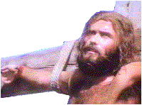
More facts you should know
We read also of the cleansing of the temple, the conversion of Nicodemus, His conversation with the woman of Samaria, His sermon on the mount, choosing His twelve disciples, His forgiveness of the woman taken in adultery, the garden of Gethsemane experience, the arrest, the trials,
the trip to Calvary,
and the crucifixation at Golgotha. Praise the Lord
this was followed by the resurrection (It was a physical resurrection) and His ascension into heaven 40 days later.

Slide 38
I have tried my best to give you some of what the Bible says about the person of Jesus Christ.
Of course, it has only been a drop of water in comparison to the ocean. No person could ever cover completely the subjects of the Lord Jesus Christ.
Now, the question is, What do you think of Christ?
Is He just a man? Or some sort of a spirit like all of the cults and false religions say He is?
Mat. 16:16 “Simon Peter answered (Jesus) and said,
You are the Christ, the Son of the living God.”

Slide 39
Jesus said in John 14:6 “I am the way, the truth, and the life: no man cometh unto the Father, but by me.”
John 5:24 “Verily, verily, I say unto you, He that heareth my word, (you have heard today His word) and believeth on him that sent me, hath everlasting life, and shall not come into condemnation; but is passed from death unto life.”
Now, the question is, What are you going to do with Jesus who is the Son of God?

Slide 40
Are you 100% sure you are going to heaven when you die?

Slide 45
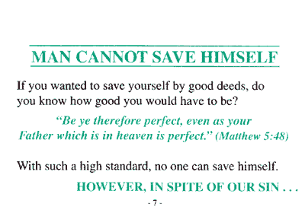

Slide 55
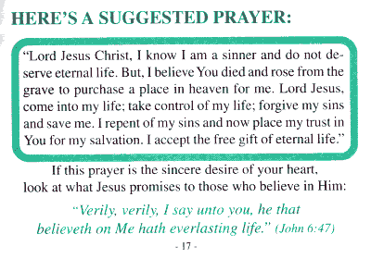

Slide 58
A PROMISE FROM GOD
1 John 5:11-13 “And this is the record, that God hath given to us eternal life, and this life is in his Son. He that hath the Son hath life; and he that hath not the Son of God hath not life.
These things have I written unto you that believe on the name of the Son of God;
that ye may know that ye have eternal life...”

Slide 59
I LOVE THIS SONG
More about Jesus; in His Word, Holding communion with my Lord; Hearing His voice in every line, Making each faithful saying mine.
TO LOVE JESUS IS TO KNOW HIM.
THE ONLY WAY WE CAN KNOW MORE ABOUT JESUS IS TO READ AND HEAR WHAT THE BIBLE SAYS ABOUT HIM.
More about Jesus; on His throne, Riches in glory all His own; More of His kingdom’s sure increase; More of His coming, Prince of Peace.

Slide 60
Would you pray with me?

